Slide 1
Preferred Neighborhood

Slide 2
Who will be interested?
Anyone who is looking for establishing in Toronto city would like to know about the neighborhood . So they can look for the neighborhood that bests suit for them.
For example we all know that people have different interests and hobbies, let’s suppose there is a person who is a gym freak and he goes to gym 6 days a week, then ofcourse he don’t want to waste his time in travelling to the gym so, he would prefer a gym near his house.

Slide 3
Data acquisition and cleaning
Postal codes , boroughs and neighborhoods of Toronto city were scraped from the wikipedia.
Foursquare is used to get the venues around all the postal codes.
There are approx. 4900 venues in 1 km radius around the postal codes.
The total number of unique venue categories are 339.

Slide 4
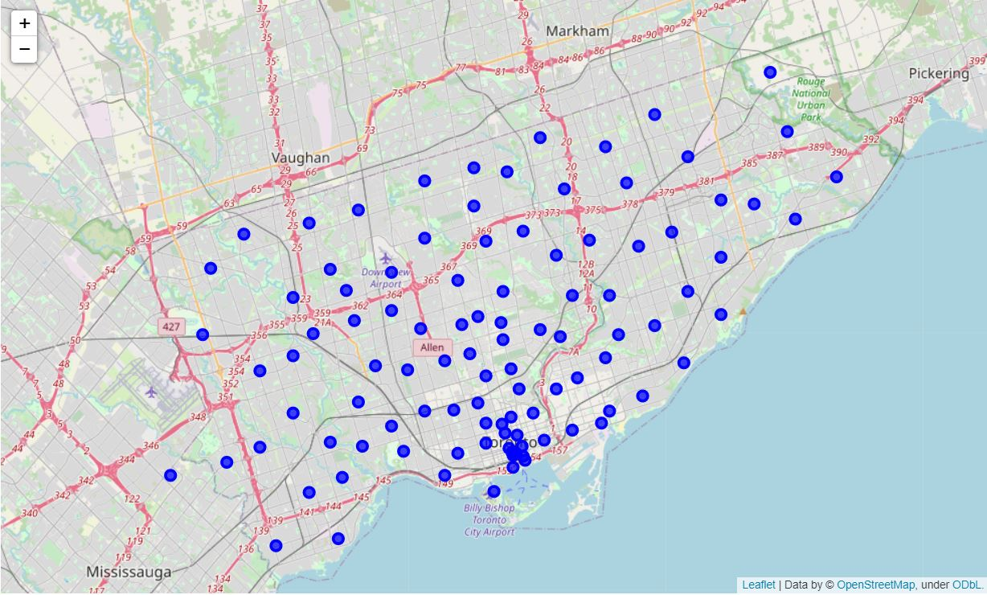
Approach for the result
First of all we scraped the data from wikipedia and converted it into a dataframe.
We used the coordinates of postal codes to locate them on the map.

Slide 5
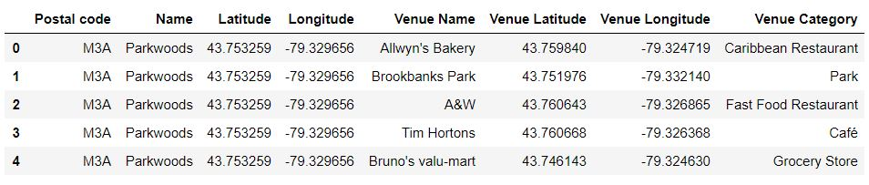
Then venues around the postal codes were retrieved using Foursquare data.

Slide 6
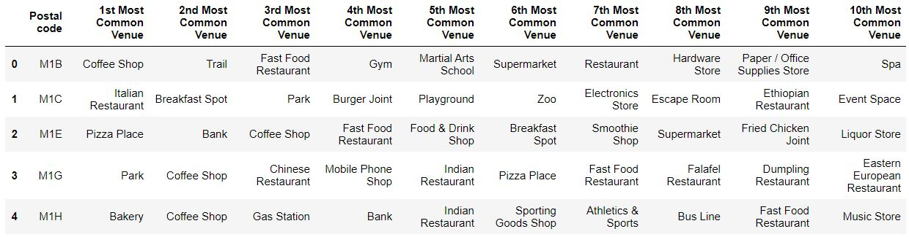
Then by using one hot encoding top 10 venues of each postal code was retrieved.

Slide 7
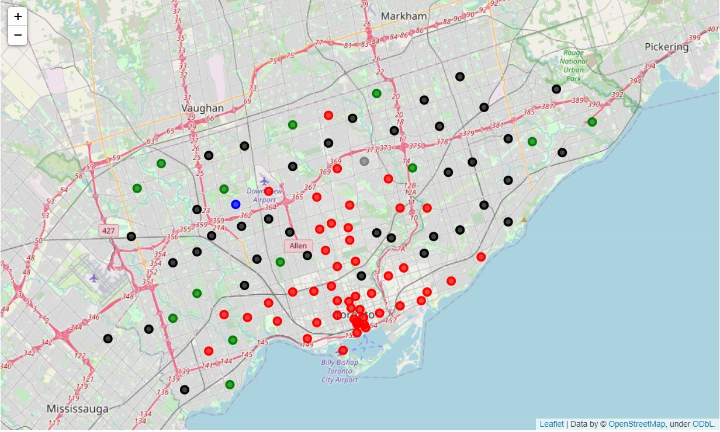
Then at last data is clustered using KMeans clustering.

Slide 8
Result and conclusion
The top 10 venues around all the postal codes of Toronto city were found.
In the final clustered map two postal codes were unique. The one that is coloured in blue is having postal code M3M and the one in grey have postal code M2L and there unique colour signifies that these two postal codes have most unique neighborhood.

Slide 9
Future directions and useful for
This will be helpful for the peoples who are moving to the Toronto city.
This will also be helpful for the businessman for example someone wants to open an italian restaurant so they might want to know in which area the italian restaurants are less so they can open the restaurant there.
It can be used to differentiate between two neighborhoods or we can know that which neighborhoods are very similar to each other.

